Slide 1
Hashing and Integrity
The mid term presentation.
on

Slide 2
Hashing and Integrity
Presented to
Shaikat Majumder
Course Instructor, Creative IT
Presented by
Md. Safayat Zahir Tusar
Date: 4th May 2024

Slide 3
Hashing and Integrity
Hash function or Hash algorithm creates a unique digital fingerprint of Data.
The digital fingerprint of data is called digest or message digest or simply Hash.
Hash algorithm is primarily used for comparison purpose ,not for encryption.

Slide 4
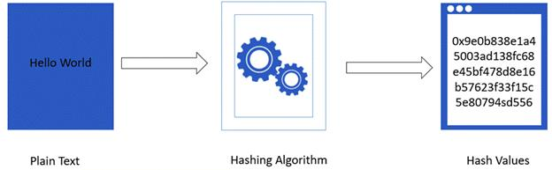
Hashing and Integrity
/digest

Slide 5
Hashing and Integrity
3 BASIC CHARACTERISTICS
Secure
Fixed Size
Unique

Slide 6
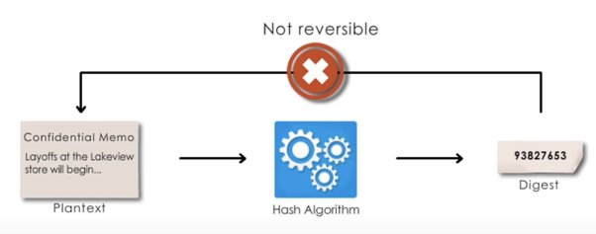
Hashing and Integrity
3 BASIC CHARACTERISTICS
Secure:
Non- reversible function

Slide 7
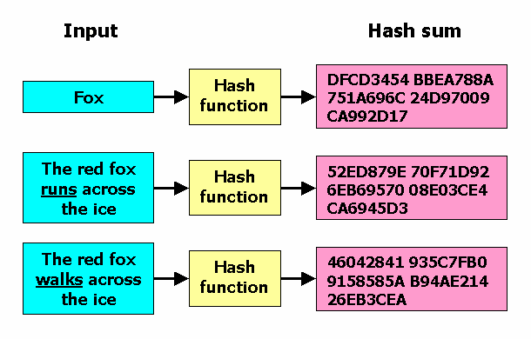
Hashing and Integrity
3 BASIC CHARACTERISTICS
Fixed Size:

Slide 8
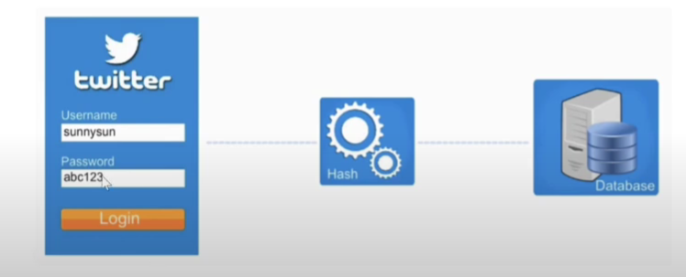
Hashing and Integrity
3 BASIC CHARACTERISTICS
Unique:
Commonly used for password
E99a18c
428cb38d
5f26085367
8922e03
abc123

Slide 9
Hashing and Integrity
All passwords should be stored in the form of digests .
Every time we login our password is hashed into a digest, which then compared against the one stored in the database.
E99a18c
428cb38d
5f26085367
8922e03
abc123

Slide 10
Hashing and Integrity
The main facts of the Hashing Function:
One-Way Function
Uniqueness and Uniformity
Speed and Efficiency
Collision Resistance
No Key Management Required

Slide 11
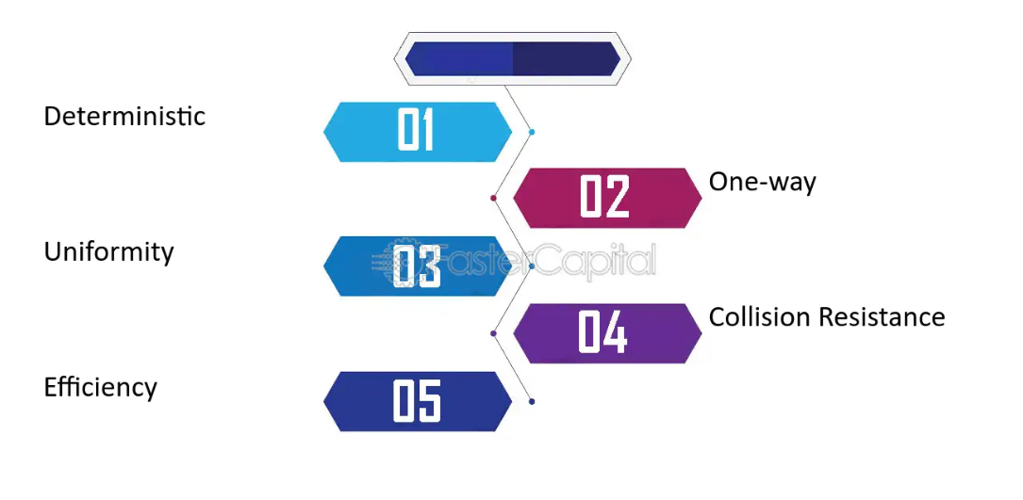
Hashing and Integrity
The main facts of the Hashing Function:

Slide 12
Hashing and Integrity
Thank You

Slide 13
Hashing and Integrity

